Slide 1
Board Game Reviews
NONPARAMETRIC
STATISTICS
Davide Carrara
Francesco Romeo

Slide 2


The dataset
The dataset is obtained through R-Tidy-Tuesday and originates from BoardGameGeek.com, the most relevant website in the field of board games
BGG contains detailed information regarding 21631 games, provided either by users or by the producers. BoardGameGeek also provides an exchange platform, whose data we can access.
Lastly, we can also use the text data of all reviews in the portal.

Slide 3
Main features
Complexity of the game evaluated by users
Category of the game: setting and main dynamics – (‘Abstract’, ‘Medieval’, ‘Medical’, …)
Mechanic: how the game is physically played – (‘Roll a dice’, ‘Card Game’, …)
Ratings provided by users on BoardGameGeek: average, number of reviews, standard deviation
Players information: minimum and maximum number, minimum age
Average playing time indicated by the producer
Appeal: number of users owning the game or wishing / trading for it

Slide 4
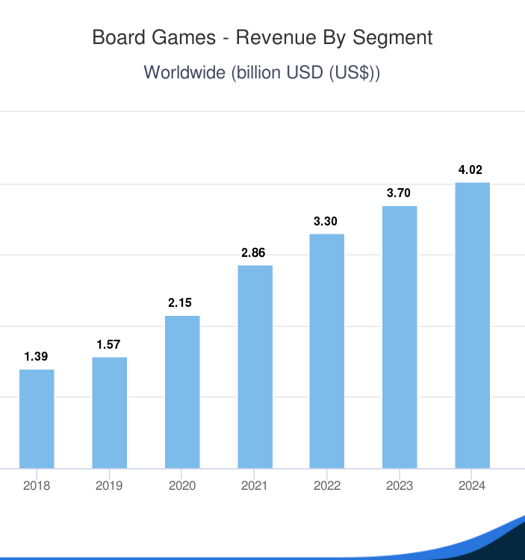
Why Board Games?
Board games are becoming more and more popular nowadays. Their popularity started growing during covid-19 outbreak, and people now can’t stop playing them!
Thanks to many recent online playing environment, it is now possible to play almost any existing board game with a little expense.
Boardgame producers need now more than ever to understand the key factor driving the success of a game, but in terms of sales and rating from hardcore players.

Slide 5




Depth Measures / Robust Statistics
THE
NONPARAMETRIC APPROACH
Look for outlier or errors in the description of games and handle them through methods of robust statistics
Permutational Tests
Analyze difference in rating and complexity among the most common categories
Our Questions
Which dynamics or categories make a game more popular?
Can we predict the rating of a game and its commercial success?
NonParametric Regression
Provide a model for the rating of a game given its characteristic features
Conformal Prediction
Improve our prediction with confidence bands

